Slide 1
Welcome to the IDEAS Guide Workshop
(Innovating, Designing, Evaluating and Applying to Small-scale media and communication projects)

Slide 2
Workshop guidelines
We will respect and listen to each other.
We will speak up and share knowledge.
We will be on time (including facilitators).
We will criticise ideas, not people.
We will follow these guidelines even after the workshop is over. This means continuing to respect each other and limiting criticism to ideas and issues, not people.
(Any others?)
(Mobile phones during the workshop?)

Slide 3
Workshop schedule
Time | Activity
Day 1
9:00 | Welcome and introduction
 | Module 1: Understanding the role of evaluation and learning in innovation
 | Module 2: Defining your idea
11:05 | Morning tea
 | Module 3: Engaging with stakeholders
12:45 | Lunch
 | Module 4: Stakeholder participation and communication
3:05 | Afternoon tea
 | Module 5: Ethics
 | Brief recap and wrap up the day
5:00 | Finish Day 1

Slide 4
Workshop schedule (continued)
Time | Activity
Day 2
9:00 | Introduction, recapping on the previous day
 | Module 6: Planning data use
 | Module 7: Asking the right questions
10:35 | Morning tea
 | Module 8: Planning information and data collection
12:45 | Lunch
 | Module 9: Making sense of data
3:25 | Afternoon tea
 | Module 10: Reporting and sharing
 | Brief recap and wrap up for the day
5:00 | Finish Day 2
Day 3
9:00 | Working individually or in teams on finalising materials and plans, one-on-one consultations with facilitators
12:30 | Finish Day 3

Slide 5
Overview of the IDEAS Guide
Guide Module | Objectives and Activities
Introduction to the IDEAS Guide | An introduction to the guide and how it can be used for designing, evaluating and learning about small-scale communication projects.
PART 1
Module 1: Understanding the role of evaluation and learning in innovation | Framing evaluation as continual learning. Evaluation can help you to listen and learn about what’s working, so you can share these insights and lessons with communities, organisations and funders.
Module 2: Defining your project goals and priorities | What are we trying to do? How are we trying to do it?
Module 3: Understanding the people connected with the project (Stakeholders) | Who has an interest or role in our project design and evaluation? We map out who the stakeholders are in your project.
Module 4: Stakeholder participation and communication | How can you best communicate and engage with the different stakeholders in your project?
Module 5: Doing the right thing by the people involved with the project | What are the potentially ethical issues in media and communication projects and evaluation? How can we prevent these from becoming problems?

Slide 6
Overview of the IDEAS Guide continued
Guide Module | Objectives and Activities
PART 2
Module 6: Planning data-use | What is our overall timeline for sharing our findings and insights? How can we build-in continuous learning? What are the most appropriate ways to share our insights?
Module 7: Asking the right questions | Based on our main goals, what are the key evaluation questions?
Module 8: Planning information and data collection | Which data collection methods will give us the best information to answer our questions? Which methods are realistic? What is the role of ethics in data collection?
Module 9: Making sense of data | Now that you have collected the data, how can you analyse it to find patterns and trends?
Module 10: Reporting and sharing | Tips on presenting and reporting on your data, including non-traditional and visual methods.

Slide 7
Part 1

Slide 8

Module 1
Understanding the role of evaluation and learning
in innovation

Slide 9
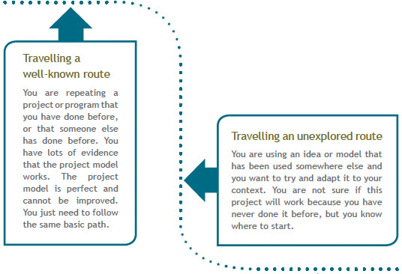
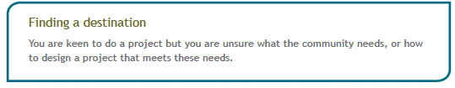
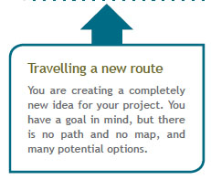
Activity 1: Understanding which type of course you are travelling

Slide 10
Activity 2: Considering the type of evaluation that matches your learning pathways
Finding the Route to travel | Travelling the well-known route |  |  | Travelling an unexplored route | Travelling a new route
Wait | Track and monitor |  |  | Test and learn | Intensive learning and innovation
Before moving ahead, you will need to consult with the community and ask, ‘What is needed?’ When you have a project, you can return here to find the right path to take, and then continue on through the guide. | Since you know the path works, your main task is to continually check that everyone stays on track and that processes are being followed correctly. The main focus of your evaluation plan will be monitoring and tracking to make sure things are still going well (see Module 8). Unexpected events can still happen on this path, and there may be a need for innovation and a change of plans in response to your data. |  |  | You will need to test your idea in the field, and look at processes and impacts to assess what’s working, and what’s not working as expected. | Because your project is in an experimental or pilot phase, you need to carefully document processes, and give your organisation time to reflect on achievements and challenges. This resembles sailing in that you may need to change tack or direction.
Useful learning questions for your path
 |  | How is it going? You will need to set targets and track progress against your goals. | What results have been produced and for who? What has (or has not) worked? |  | How is it going? What has (or has not) worked? How could you improve?

Slide 11
Differences between common thinking about evaluation and the IDEAS Guide evaluation approach
Common thinking about evaluation | IDEAS Guide evaluation approach
Evaluation is something that is done at the end of a project. | Evaluation is design at the beginning and is a process of continual learning throughout the project.
The evaluation is primarily for funders. | The evaluation is for a range of interested stakeholders, including he project team and funders.
The purpose of evaluation is to prove to the funders that the project was a valuable investment. | The purpose of evaliation is to listen to stakeholders, adapt and improve the project, and share what you have learned with all interested stakeholders, including funders and donors.
Funders decide the design and plan for the evaluation. | The project team should lead the design and plan for their evaluation (with interested stakeholders), so that is is relevant to their needs.
To be an evaluator you must have expert skills. | Most organisations are already doing evaluative activities, such as asking fr feedback. These processes can be strengthened.
Evaluation is done by people from outside the organisation. | When a project team plans and manages their own evaluation, the evaluation findings are more relevant and useful, and can be used to improve the project or future projects.
Evaluation is expensive and time consuming. | Evaluation plans should be realistic. There are options that suit small-scale projects.

Slide 12
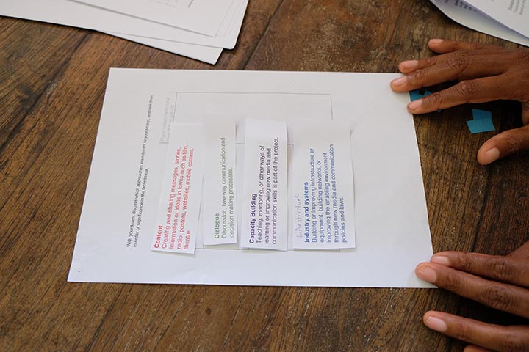
Module 2
Defining your project goals and priorities

Slide 13
Activity 1: What are you trying to do?
If your project is successful, how is the future different to the present?

Slide 14
Four basic approaches most media and communication projects use
Content Creating and sharing messages, stories, information or ideas in forms such as film, radio, posters, websites, mobile content, theatre. | Voice and Dialogue Discussion, two-way communication and decision making processes.
Capacity Building Teaching, mentoring, or other ways of learning or improving new media and communication skills is part of the project. | Infrastructure and systems Building or improving infrastructure or equipment, building networks, or improving the enabling environment through new media and communication policies and laws.

Slide 15
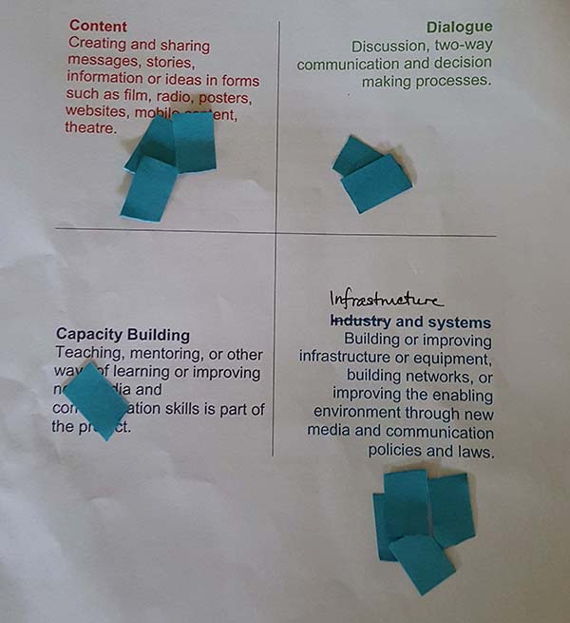
Activity 2: How are you trying to do it?
Step 1: Sorting and comparing project approaches using objects

Slide 16
Activity 2: How are you trying to do it?
Step 2: Ranking different project approaches

Slide 17
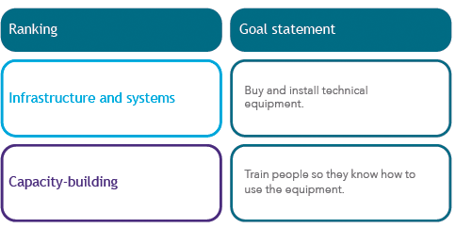
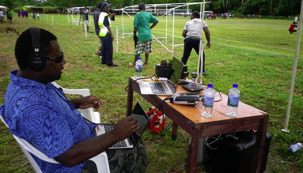
Activity 2: How are you trying to do it?
Step 3: Goal statements (an example)

Slide 18
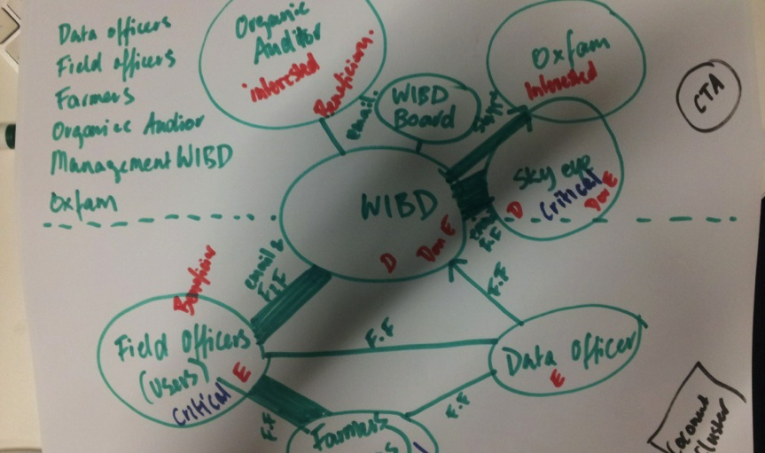
Module 3
Understanding the people connected to the project (stakeholders)

Slide 19
Activity: Stakeholder mapping
Make a list of stakeholders. Write stakeholders on sticky notes.
Arrange them according to categories.
Put the project name in the middle of the page; move the stakeholders who are most connected to the project closer, and those who are least connected further away.

Slide 20
Activity: Stakeholder mapping (step 4)
4. Indicate stakeholder’s interest (C, I, K. D). Stakeholders may:
have a critical role in making the project a success | C = Critical role
be interested in the project | I = Interested
know about the project but not be committed to it | K = Know about
have a vested interest in disrupting the project (for example, competitors). | D = Disrupting

Slide 21
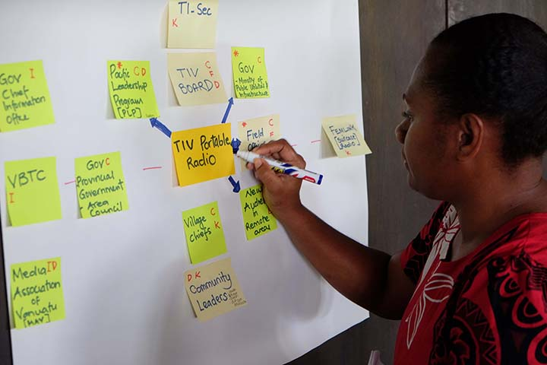
Module 4
Stakeholder participation and communication

Slide 22
Engaging different kinds of expertise
Knowledge needed for the project
Technical Expertise
Local Expertise

Slide 23
Ideas for bringing in more local expertise
Content
Capacity-building
Voice and Dialogue
Infrastructure and systems
Asking communities what they want the content to be about.
Including participants in processes for making content, such as letting them use the camera.
Showing stakeholders drafts of the content so that they can give feedback.
Asking participants what kind of training they want.
Asking participants which kinds of experts they would like to help them.
Adapting your training to suit the participants.
Inviting communities to decide the agenda for dialogue activities.
Inviting communities and community leaders to lead dialogue activities.
Asking the ‘users’ of a system what their needs are, and how they would like the system to work.
Holding round-table meetings to discuss media and communication policy needs.

Slide 24
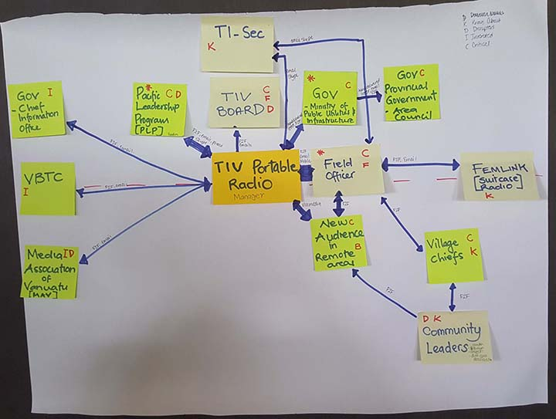
Culture and customs
Across different cultures, there are very different protocols and customs designed to show respect.
For example, when creating the stakeholder map (pictured), a project team recognised that to be successful the team needed to:
  talk to government officials
  Meet face-to-face with village chiefs
  get approval to carry out the project.
  This needed to happen before talking to the rest of the community.
  Other examples: saying a blessing or prayer; ceremonies; gender roles.

Slide 25
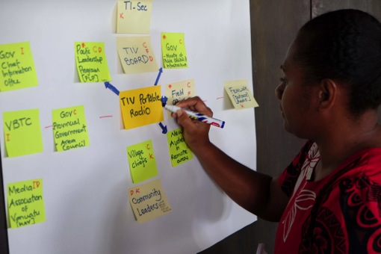
Activity: Thinking about your engagement and communication styles
Using your stakeholder map:
Draw a thick line to represent strong engagement/regular communication; a thin line where you communicate less often and less openly.
Think about communication styles and needs.
Think about the balance of expertise.

Slide 26
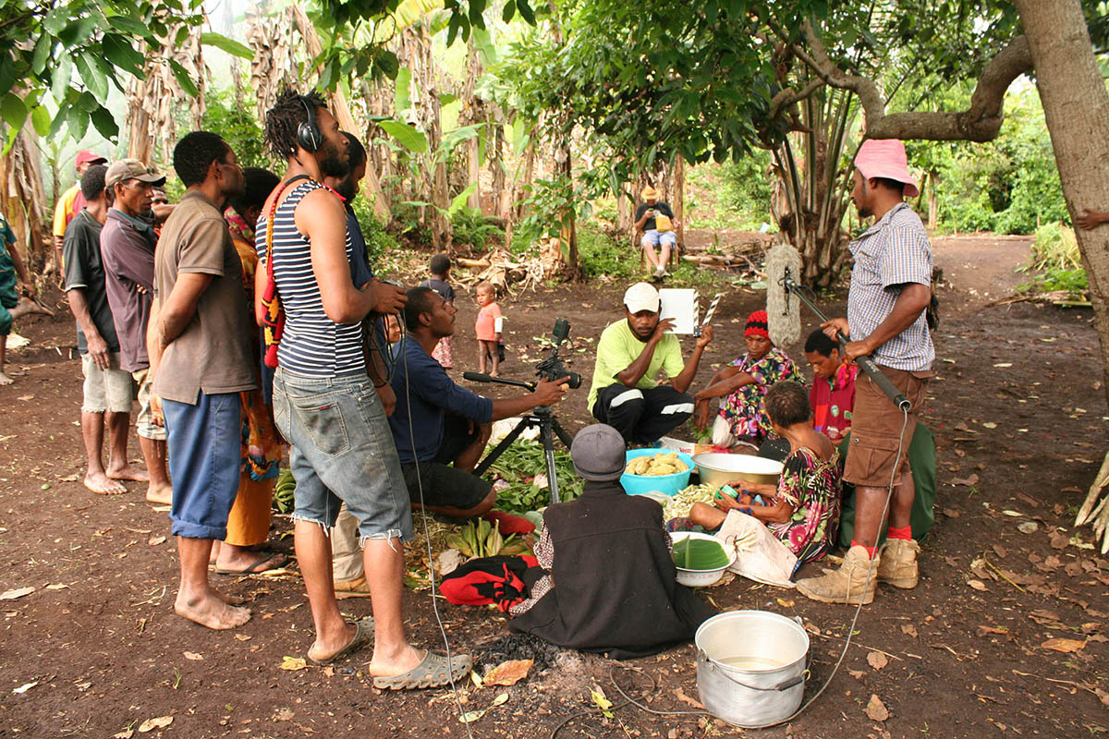
Module 5
Doing the right thing by people involved with the project (ethics)

Slide 27
Considering the risks
Minimising the risks.
Explaining the project, seeking permission (‘informed consent’).
How people are presented to others (‘representation’).
Children and young people
Harm and offence

Slide 28
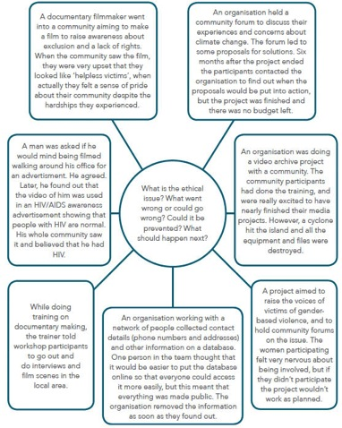
Activity 1: Examples of ethical risks
Read the examples:
What is the ethical issue?
What went wrong?
Could it have been prevented?
What should happen next?

Slide 29
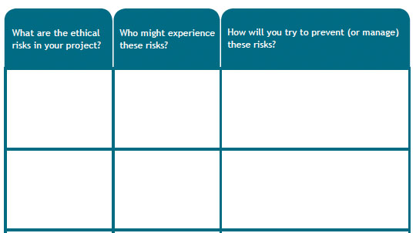
Activity 2: Considering your own project’s ethical risks
Look at your stakeholder map.
Think about, What are our ethical risks?
How can we prevent these?

Slide 30
Day 2: Welcome back

Slide 31
Recap of part 1
Evaluation is not just for the funders.
Good evaluation supports learning.
In order to learn, evaluations need to be planned from the beginning.
Part 1 was mainly about getting a clearer picture of the design.

Slide 32
Introduction to part 2: Developing an evaluation plan
You are probably already doing ‘evaluation’ work. How can you do it more systematically?
In monitoring and evaluation:
systematic information and feedback = ‘data’
‘Data analysis’ = systematic process for making sense of (‘analysing’) your data, to help generate ‘evidence’

Slide 33
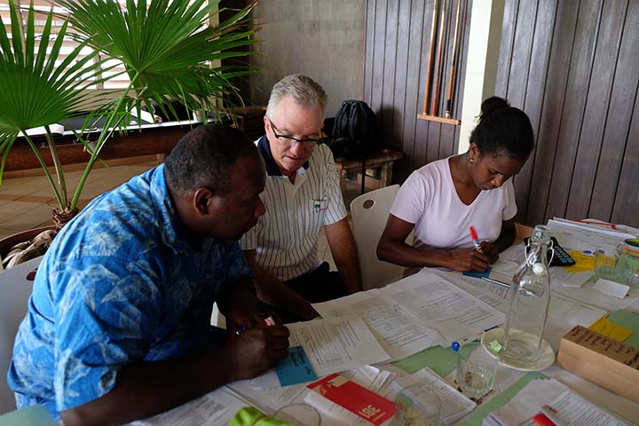
Module 6
Planning data-use

Slide 34
Activity 1: Uses and users of evaluation
Refer to your stakeholder map.
Who might want to use the evaluation data?
What will they use it for?
When they will use it and how early in the project will they need the data?

Slide 35
Activity 2: Data-use calendar
A data-use calendar can help with planning when you will need information to make improvements.
Either:
Create a new data-use calendar (if you don’t already have one); or
Build data-use into your existing project calendar.
Add key project milestones and activities (see the IDEAS Guide for details).
Based on this, when will you collect, analyse and use data?
Do you have enough time?

Slide 36
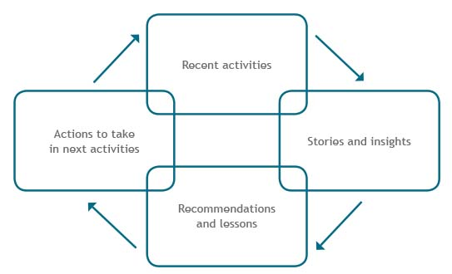
The learning loop: A tool for continual learning

Slide 37
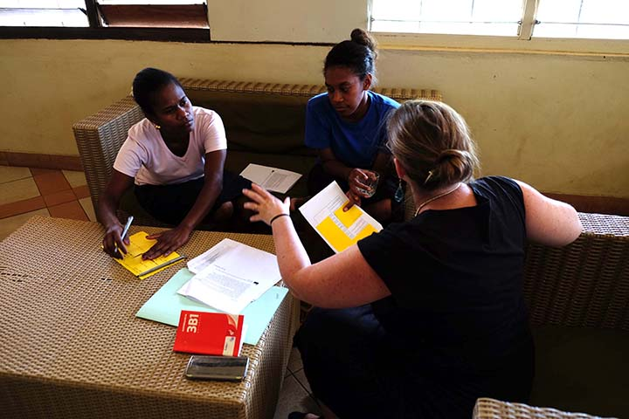
Module 7
Asking the right questions

Slide 38
Activity 1: Thinking again about the uses and users of evaluation
Which stakeholders should be involved in identifying the key questions?
How will you involve them?
  Will you inform them (tell them your decision);
  Consult with them (ask them for their comments and feedback); or
  Collaborate with them (work as equal partners to make decisions)?

Slide 39
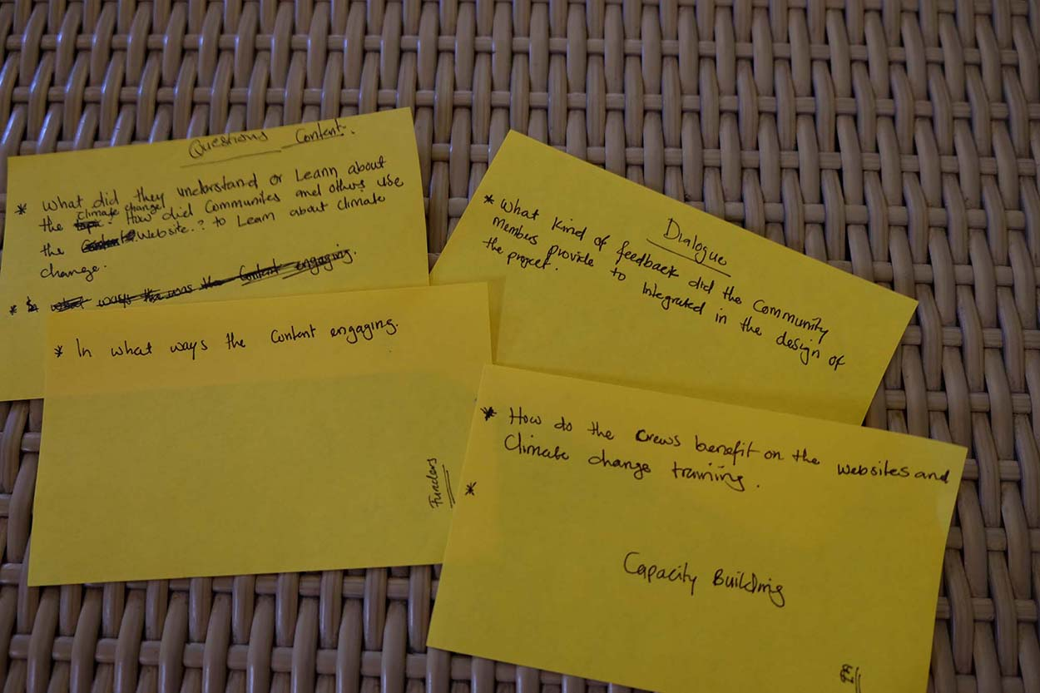
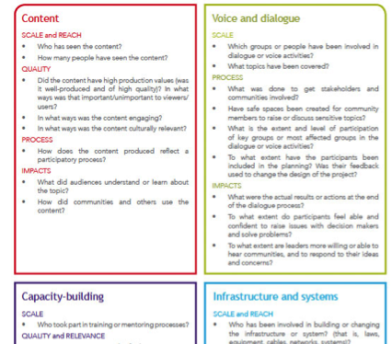
Activity 2: Specifying the key evaluation questions
Read through the list of questions.
Adapt or write new questions.
Write questions on sticky notes.
Do you have too many questions? Pick the 2-4 most important questions.
Which questions matter most to your stakeholders/key users?
How does this compare to your ranking (module 2)?

Slide 40
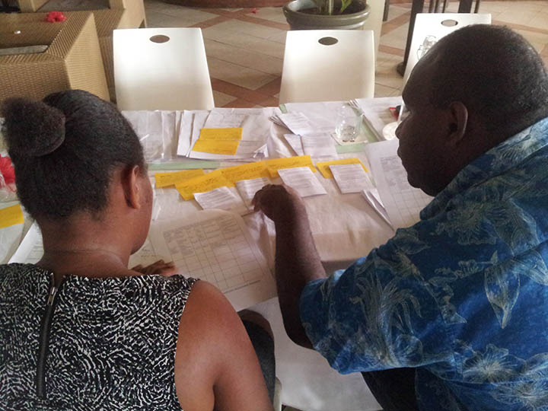
Module 8
Planning information and data collection

Slide 41
Tracking project activities and achievements (‘monitoring’)
Tracking (‘monitoring’) = keeping good records, signals that you are on track.
Evaluation = answering your key questions.
Things you could track:
  the number of workshops or meetings (including dates and agendas);
  the number of people who have attended your workshops or meetings (including the number of men and the number of women);
  the number of pieces of content produced;
  the number of people who have viewed, listened to, or used your content or system.
Gives a quick indication of progress.
Some stakeholders (often funders) might be interested in this information.
More tracking tools in the IDEAS Guide.

Slide 42
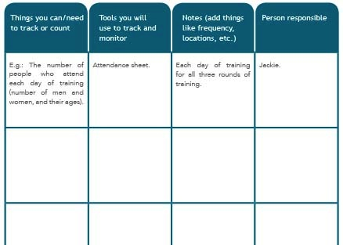
Activity 1: Creating a monitoring plan

Slide 43
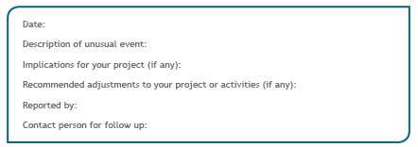
Tool: Capturing the unexpected
Tracking and monitoring works for things that are predictable.
Unexpected events and changes (positive and negative) can be useful moments for learning.
Option: Unexpected event tracking tool

Slide 44
Activity 2: Choosing evaluation methods using methods cards
5. Which (combination of) method(s)
will be best/most realistic to answer
your questions? (Start with the most
important questions.)
Each question should be on a sticky note.
Read through the methods cards.
Place methods card that seem useful next to evaluation question(s).
What would the information source be?

Slide 45
Ethics in data collection and evaluation
‘Informed consent’.
Ongoing communication and trust.
People have the right to change their minds.
Privacy:
  Are you collecting personal information?
  Who will have access?
  How will it be stored?
  Will you ask for people’s names in the evaluation?
  Will people’s names be used in reports?

Slide 46
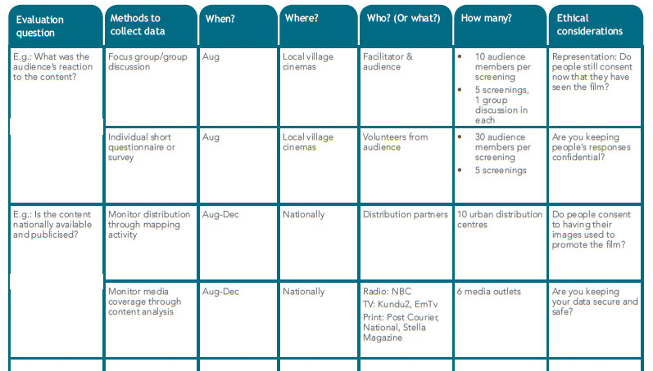
Activity 3: Compiling an evaluation plan

Slide 47
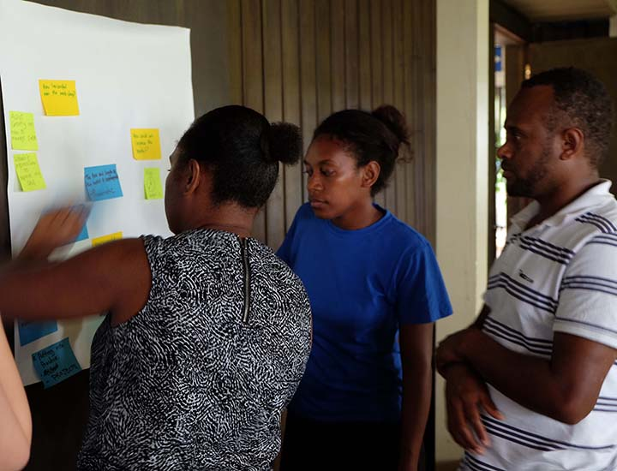
Module 9
Making sense of data

Slide 48
Managing data
Do you have examples of where data has been lost?
What strategies do you use for managing data?

Slide 49
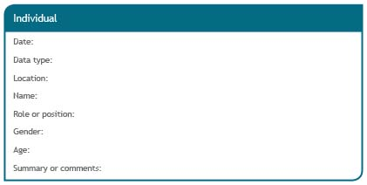
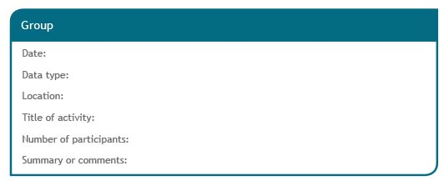
Managing data: An example template
Keeping good records of data as you collect it.

Slide 50
Making sense of data (analysing data)
Data based on numbers (Quantitative)
Data based on words, stories, images
(Qualitative)
There are two general kinds of data:
Data analysis = making sense of data by looking for patterns.
The way data is analysed depends on which type it is.
(Hint: The methods cards indicate the type of data.)

Slide 51
Activity: Making sense of data
(learning by doing)
Workshop evaluation

Slide 52
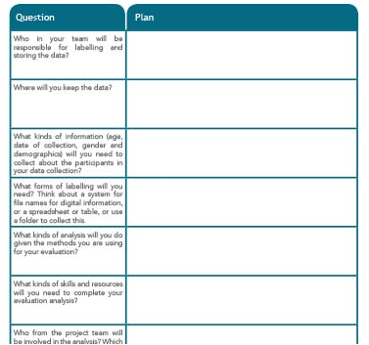
Activity: Data management and analysis plan
Develop a data management and analysis plan by filling in the table.

Slide 53
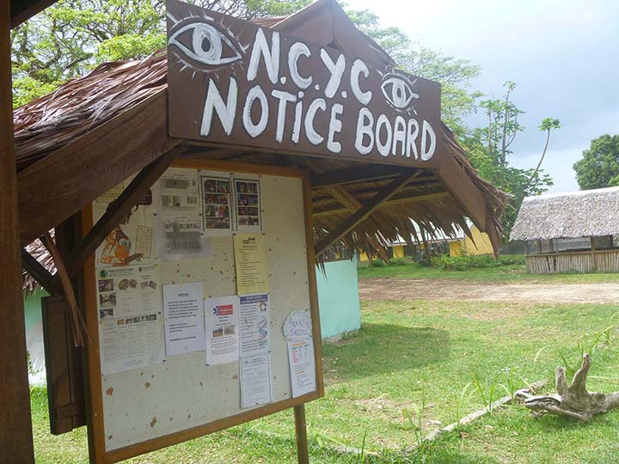
Module 10
Reporting and sharing

Slide 54
Planning how to share your findings
Traditional reporting
Innovative reporting
Written report following traditional structure (Summary, Introduction, Methodology, Findings, Conclusions)
For example: Videos, presentations, exhibitions, etc.
Useful when it is difficult to explain with text only.

Slide 55
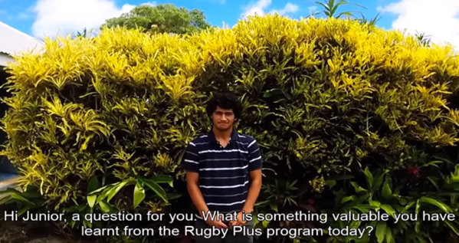
Video using a ‘vox-pop’: An example of non-traditional reporting
https://www.youtube.com/watch?v=RkEUpX7gSt4

Slide 56
Activity: Choosing reporting options using reporting cards
Read through the reporting cards.
Refer back to your stakeholder map. Think about:
  Who do you want to report to?
  How can you best communicate?
Add your plans for sharing findings to your data-use calendar.

Slide 57
Concluding discussion

Slide 58
Key insights
(delete this text and add the group’s insights)

Slide 59




IDEAS Guide Acknowledgements
The IDEAS Guide was written by:
Jessica Noske-Turner
Heather Horst
Jo Tacchi
Full acknowledgements page 4 of the IDEAS Guide.

